Slide 1
《英语国家社会与文化入门》(下册）
The Society and Culture
of Major English-Speaking Countries
An Introduction
(Book Two)

Slide 2
The United States of America Unit 9 Social Movement of the 1960’s

Slide 3
Quiz
Give the English and a brief explanation for the following:
马丁· 路德· 金
民权运动
反战运动
言论自由运动
反主流文化
妇女解放运动

Slide 4
Focal Points
The definition of social movements in the U.S. context
Reasons behind the making U.S. social movements in Post-World War II America
The contributing factors to make a social movement possible:
-The people in the movement
-The Organization in the social movement
-The tactics used by movement participants
-Social movements’ messages and goals
The Civil Rights Movement, Anti-War & Women’s Lib

Slide 5
This Unit Is Divided into Six Sections
The Definition of Social Movements
II. The Reasons behind the U.S. Social Movements in Post-World WII
III. The Contributing Factors to Making a Social Movement Possible
IV. The Civil Rights Movement
V. The Youth Movement/Anti-War Movement
VI. The Women’s Liberation Movement

Slide 6
I. The Definition of Social Movements
"A social movement is a type of behavior.”
A collective behavior in which participants want to change existing socio-economic institutions and establish a new order of life;
A social movement must have two basics: structure and spontaneity;
A social movement must have a critical base of people;
A social movement must have a message to convey;
A social movement must have the ability to spread the message through media.

Slide 7
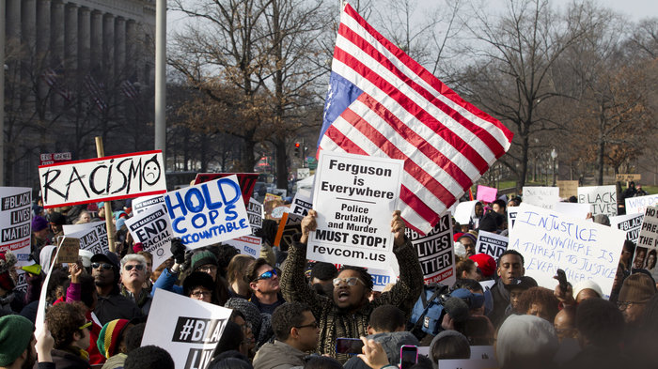
A social movement is a type of collective behavior
Protesters from across the U.S. marched in Washington D.C. in December, 2014

Slide 8
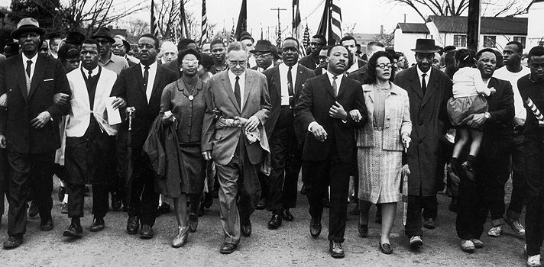
A social movement is a type of collective behavior
The Civil Rights Movement in the 1960s

Slide 9
II. The Reasons behind the U.S. Social Movements in Post-World WII
In the 1960s, three groups –Afro-Americans, young people and women --were dissatisfied with their lives.
American black people, who had a taste of life outside the racially segregated South during World War II, returned to become rebels against the old system.
Middle-class white women who had the opportunity to work in responsible jobs during World War II, felt isolated from society because they had to be housewives again.
Young people, who were known as post-WWII baby boomers, were alienated by traditional white male values in U.S. society.

Slide 10
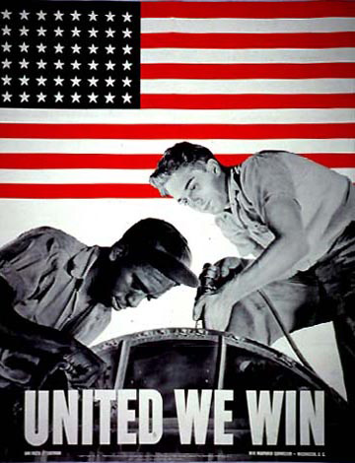
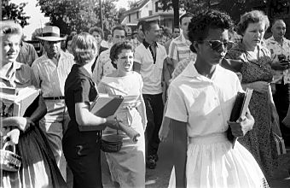
II. The Reasons behind the U.S. Social Movements in Post-WWII
Black and white workers worked side by side during WWII, yet black children still had to attend segregated schools in the South.

Slide 11
II. The Reasons behind the U.S. Social Movements in Post-WWII
Baby boomers, who were alienated by Puritan values, formed a counter culture.

Slide 12
III. The Contributing Factors to Making a Social Movement Possible
The people in the movement
-black middle class in the Civil Rights Movement
-white professionals in the Civil Rights Movement
-women, including housewives, in the Women’s Lib
-college youth in the anti-Vietnam War movement
Strategies and tactics used in the movement
-nonviolent, direct action tactics like (bus) boycotts and marches used to protest oppression
-“sit-ins” and later “teach-ins” to protest and educate the public about the war in Vietnam.
- the legal system to test laws and to force changes

Slide 13
Protesters Rally in “Justice For All” Marches in the U.S. in December 2014

Slide 14
Marches and Rallies to Spread the Message “Just for All”

Slide 15
Social Movements of the 1960s
The Civil Rights Movement
The immediate reasons: Segregation laws in Southern states in the US prevented black and white people from being integrated;
The Civil Rights Movement began when black people spontaneously protested segregation laws and created organized actions in protest of racial injustice.
The Civil Rights Movement started with actions by heroic individuals, such as Rosa Parks and Martin Luther King, Jr., backed by black organizations.

Slide 16
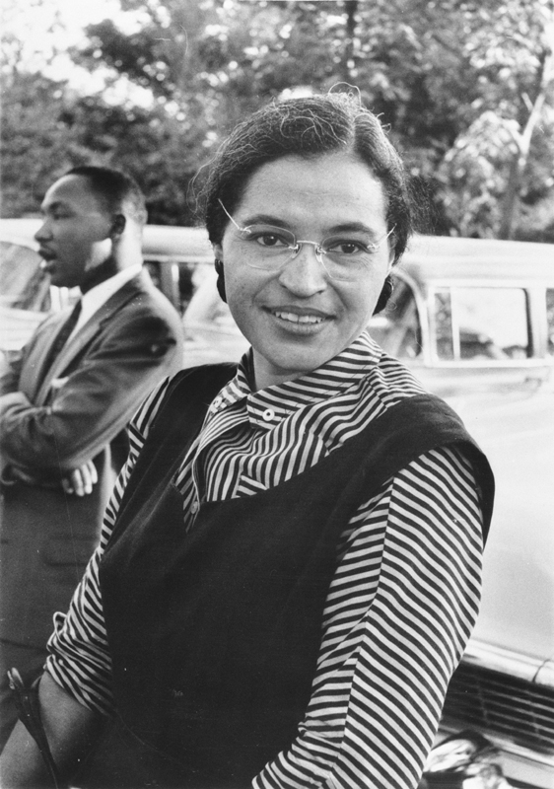
Rosa Parks (1913-2005)
Mrs. Rosa Parks was an activist in the African-American Civil Rights Movement. She almost single-handedly altered the negro progress in Montgomery, Alabama, 1955, by the bus boycott she began. The United States Congress called her "the first lady of civil rights" and "the mother of the freedom movement”. Her birthday, February 4, and the day she was arrested, December 1, have both become Rosa Parks Day.

Slide 17
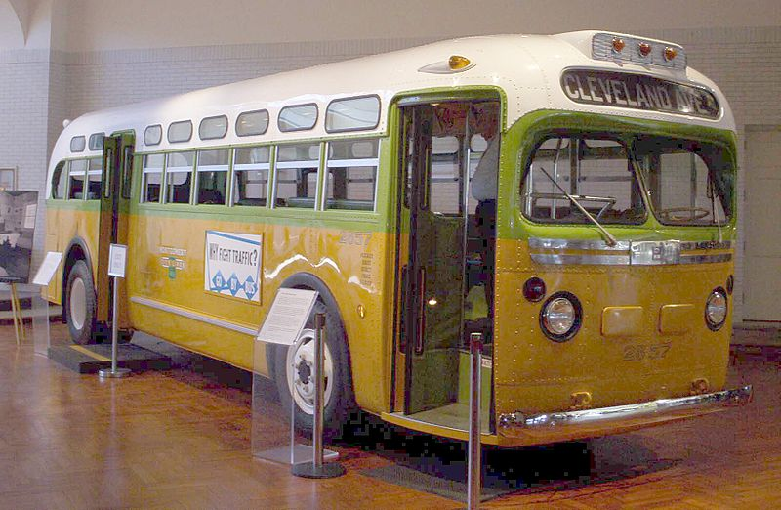
Rosa Parks (1913-2005) and the Bus Boycott
The No. 2857 bus on which Parks was riding before her arrest (a GM "old-look" transit bus) is now a museum exhibit at the Henry Ford Museum.

Slide 18
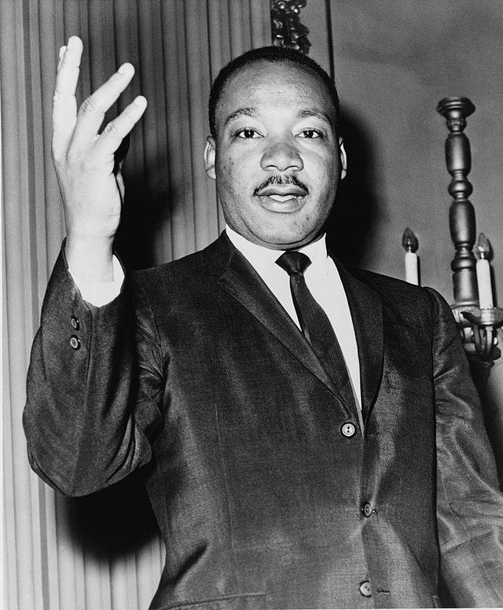
Martin Luther King, Jr.
Martin Luther King, Jr. (1929 – 1968) was an American pastor, activist, humanitarian, and leader in the African-American Civil Rights Movement. He is best known for his role in the advancement of civil rights using nonviolent civil disobedience based on his Christian beliefs.

Slide 19
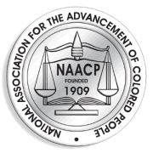
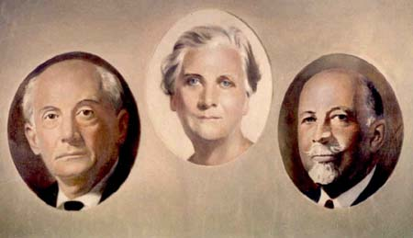
Leadership through Organizations
NAACP (the National Association for the Advancement of Colored People) came to Ms. Parks’ rescue by raising money to bail her out. They also informed other organizations about her act of civil disobedience.
Founders of the NAACP: Moorfield Storey, Mary White Ovington and W.E.B. Du Bois.

Slide 20
Leadership through Organizations
The Student Nonviolent Coordinating Committee (SNCC) was one of the most important organizations of the American Civil Rights Movement in the 1960s. Founded by Ella Baker at Shaw University in 1960, SNCC grew into a large organization that played a major role in the sit-ins and freedom rides in the South, and a leading role in the 1963 March on Washington, and Mississippi Freedom Summer.
In the later 1960s, led by leaders such as Stokely Carmichael, SNCC focused on black power, and then protesting against the Vietnam War. In 1969, SNCC officially changed its name to the Student National Coordinating Committee. It ceased to exist in the 1970s.

Slide 21
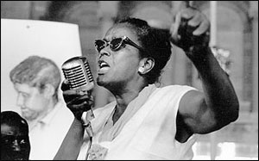
Leadership through Organizations
The Student Nonviolent Coordinating Committee (SNCC)

Slide 22
Leadership through Organizations
The Congress of Racial Equality (CORE) is a U.S. civil rights organization that played a pivotal role for African Americans in the Civil Rights Movement. Founded in 1942, CORE was one of the four largest civil rights organizations, along with the SCC, the SNCC, and the NAACP. Though still existent, CORE has been much less influential since the end of the 1955–1968 Civil Rights Movement.

Slide 23
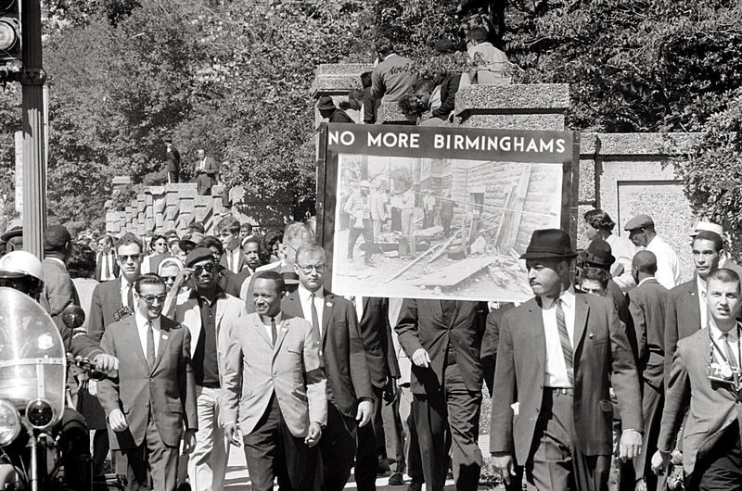
Leadership through Organizations
Congress of Racial Equality march in Washington DC on September 22, 1963 in memory of the children killed in the Birmingham bombings.

Slide 24
Leadership through organizations
The Southern Christian Leadership Conference (SCLC) is an African-American civil rights organization. Founded in 1957, SCLC was closely associated with its first president, Dr. Martin Luther King, Jr. The SCLC played a large role in the American Civil Rights Movement, especially during the Montgomery Bus Boycott victory.

Slide 25
Movement Strategies and Tactics
Direct Action Tactics
-Direct action occurs when a group takes an action which is intended to reveal an existing problem, highlight an alternative, or demonstrate a possible solution to a social issue.
-This can include nonviolent activities such as sit-ins, teach-ins, and freedom rides and peaceful marches during the 1960s movements.

Slide 26
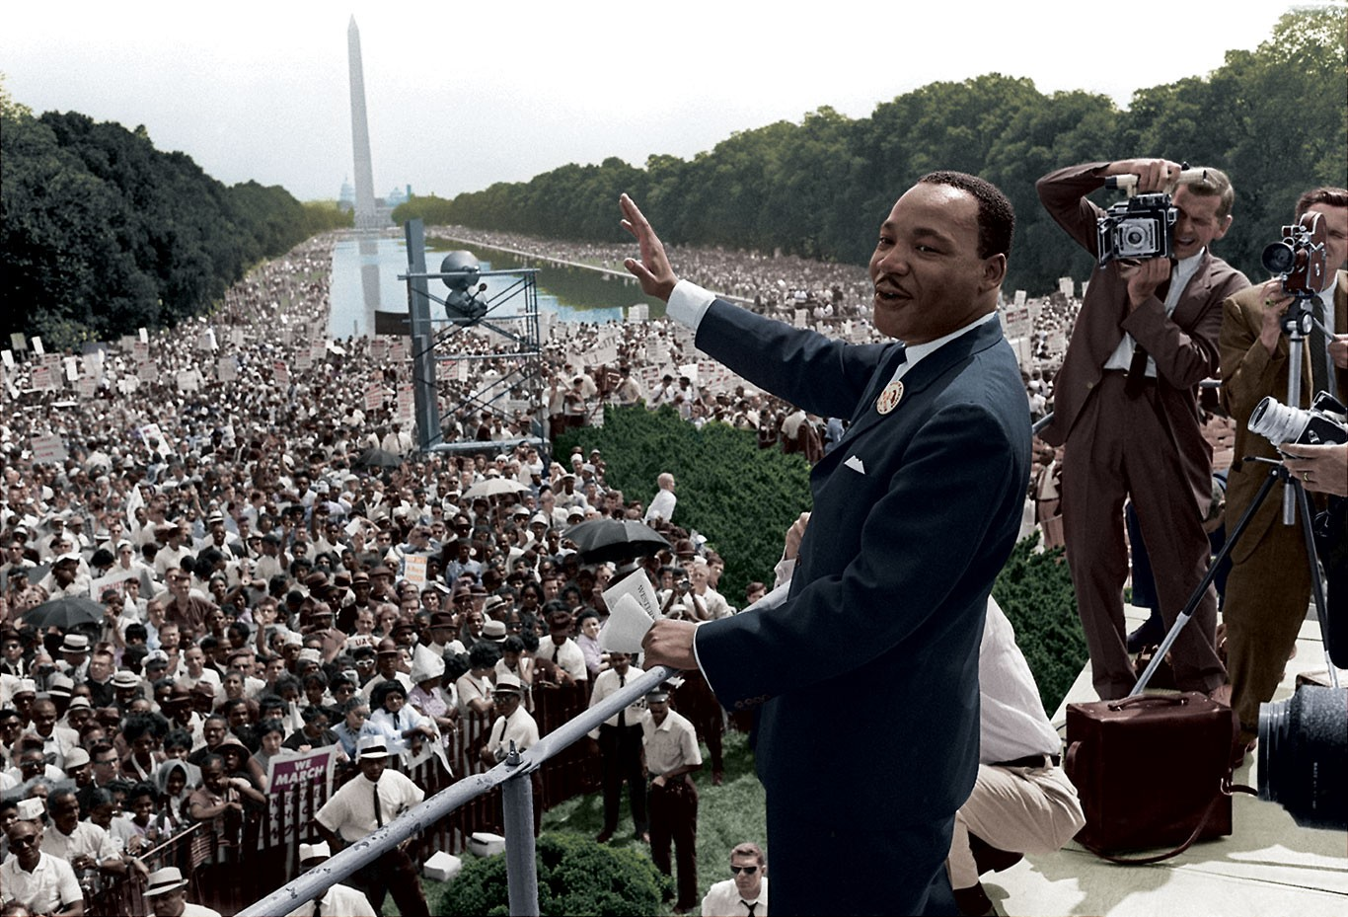
Movement Strategies and Tactics
Dr. Martin Luther King. Jr. during the peaceful March on Washington where he made his “I Have A Dream” speech to convey movement messages.

Slide 27
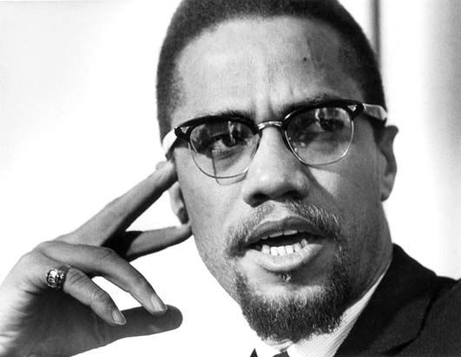
Movement Strategies and Tactics
As racial violence continued, black people began to question the nonviolent tactics used in the South, some militant black leaders even spoke in favor of black separatism and against nonviolence in fighting discrimination and racism, such as the New York based Malcolm X (1925-1965).

Slide 28
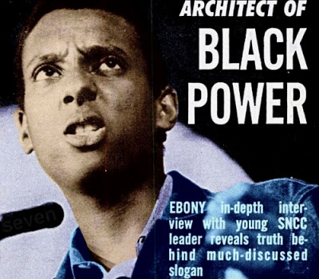
Movement Strategies and Tactics
As the civil rights leaders continued, a new chairman of SNCC, Stokely Carmichael, openly spoke about "black power”.
In 1966, the Black Panther Party for Self-Defense was organized in Oakland, California.

Slide 29
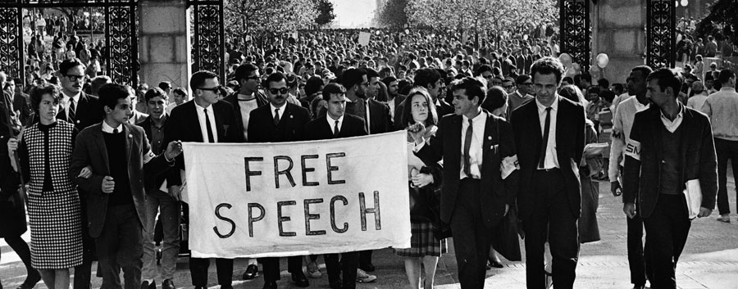
The Youth Movement/Anti-War Movement
The anti war movement was spawned by the civil rights movement.
Students who worked with the CORE and SNCC started the Berkeley Free Speech movement, and later anti-Vietnam War movement by using “teach-ins” and “sit-ins”.

Slide 30
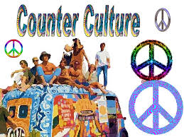
The Youth Movement/Anti-War Movement
As the youth movement spread outside the campuses, some young people formed a “counterculture.”
They rejected capitalism and other mainstream American values, such as Puritanism.

Slide 31
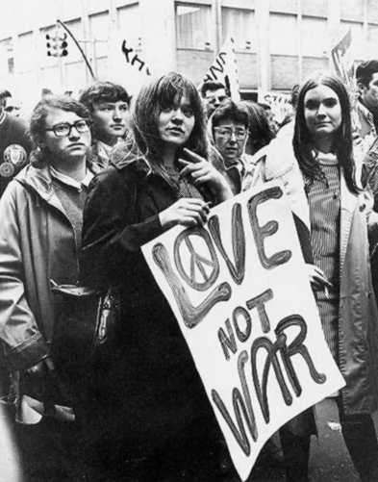
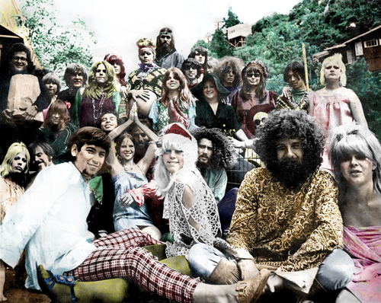
The Youth Movement/Anti-War Movement
The radical students (left) became the right arm of the Counter Culture, while the hippies (right) became the left arm of the Counter Culture.

Slide 32
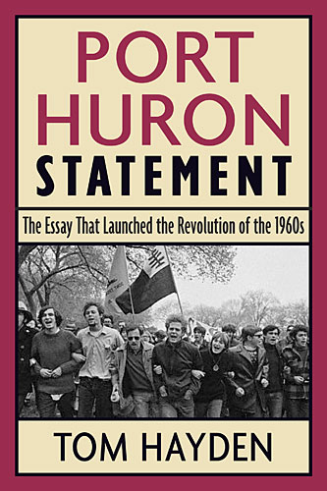
V. The Anti War Movement
Students for a Democratic Society (SDS) was a student activist movement in the United States that was one of the main representations of the New Left. The organization developed and expanded rapidly in the mid-1960s before dissolving at its last convention in 1969. (Right: The Port Huron Statement is manifesto of SDS. )

Slide 33
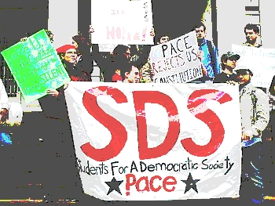
The Youth Movement/Anti-War Movement
The ant-war movement became organized as a loose coalition of many organizations and leaders was formed under a series of “Mobilization Committee to End the War in Vietnam”. The organizations included the Students for a Democratic Society(SDS).

Slide 34
VI. The Women’s Movement
The women‘s movement in the 1960s was started by three groups of women：
-The first was professionals appointed to a Commission on the Status of Women by President Kennedy in 1961.
- The second group was mostly housewives who read Betty Friedan’s The Feminine Mystique (1963)
-The third group were young activists in the civil rights and anti-war movements.

Slide 35
VI. The Women’s Movement
Betty Friedan (1921-2006) was an American writer, activist, and feminist. A leading figure in the women’s movement in 1960s in the United States, she is known for her 1963 book The Feminine Mystique, which is often credited with sparking the second wave of American feminism in the 20th century.
In 1966, Friedan founded and became the first president of the National Organization for Women (NOW), which aimed to bring women “into the mainstream of American society in fully equal partnership with men”.

Slide 36
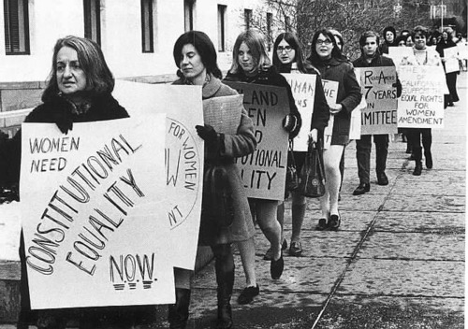
IV. The Women’s Movement
The National Organization for Women (NOW)

Slide 37
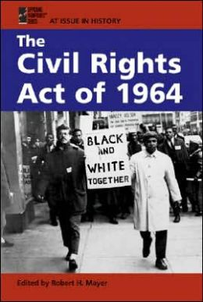
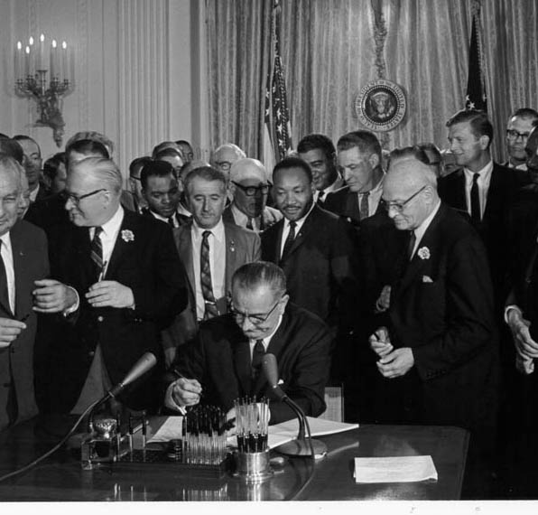
VI. The Women’s Movement
President Lyndon Johnson signed into law The Civil Rights Act of 1964, which made sexual discrimination in employment illegal. It also contributed to the making of the women's movement.

Slide 38
Questions for Discussion
A. What is a social movement? Who are working for the social movements?
B. In what way did the Civil Rights Movement change the American society and culture? What is its legacy?
C. Who is Rosa Parks? Who is Martin Luther King Jr.? What roles did they play in the Civil Rights Movement?
D. What is the public response towards the Women’s Movement in the late sixties?

Slide 39
The End
高等教育出版社
2015

